Slide 1

Multithreading and Garbage Collection
Session 16

Slide 2
Review
Multithreading allows programmers to write efficient programs that make the maximum use of the CPU.
Java provides built-in support for multithreading in the form of classes and interfaces.
When Java programs are executed, there is already one thread that is running and it is the main thread. This main thread is important for two reasons:
  It is the thread from which child threads will be created.
  Program is terminated when the main thread stops execution.
Thread objects can be created in two ways:
  Declare the class to be a sub-class of the Thread class where we need to override the run() method of the Thread class.
  Declare a class that implements the Runnable interface. Then define the run() method.
Each thread in a Java program is assigned a priority, and the Java Virtual Machine never changes the priority of a thread.

Slide 3
Review Contd…
The default priority of a thread that is created is 5.
Two of the constructors in the Thread class are:
  public Thread(String threadname)
  public Thread( )
There are two types of threads in a Java program: User threads and Daemon threads.
  The threads created by the user are called user threads.
  The threads that are intended to be "background" threads, providing service to other threads are referred to as daemon threads.
The Thread class has two methods that deal with daemon threads.
  public final void setDaemon(boolean on)
  public final boolean isDaemon( )

Slide 4
Objectives
Use multithreading with applets
Use isAlive() and join()
Explain the need for synchronization
Discuss how to apply the keyword synchronized
Explain the role of the methods wait(), notify() and notifyAll()
Describe deadlocks
Describe garbage collection

Slide 5
Multithreading with applets
Some instances of using multithreading on the web are:
  Displaying scrolling marquees as banners
  Displaying clocks or timers as part of web pages
  Multimedia games
  Animated images
When an applet-based Java program uses more than one thread, it is called multithreading with applets.
Since Java does not support multiple inheritance, it is not possible to subclass the Thread class directly in Applets.

Slide 6
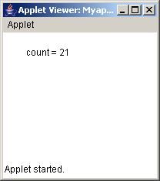
Example
/*
<applet code = Myapplet width = 200 height = 200>
</applet>
*/
import java.awt.*;
import java.applet.*;
public class Myapplet extends Applet implements Runnable
{
int count;
Thread objTh;
public void init()
{
objTh = new Thread(this);
objTh.start();
}
public void run()
{
for(count = 1; count <= 20; count++)
{
try
{
repaint();
Thread.sleep(500);
}
catch (InterruptedException e)
{}
}
}
public void paint(Graphics g)
{
g.drawString("count = "+count, 30, 30);
}
}
Output

Slide 7
Using isAlive() and join()
The main thread should be the last thread to finish.
We put the main thread to sleep for a long time within main() method and ensure that all the child thread terminate before main thread.
There are two ways to find out if a thread has terminated. They are:
  isAlive()
  join()

Slide 8
Example
class ThreadDemo implements Runnable
{
String name;
Thread objTh;
ThreadDemo(String str)
{
name = str;
objTh = new Thread(this, name);
System.out.println("New Threads are starting : " + objTh);
objTh.start();
}
public void run()
{
try
{
for (int count = 0;count < 2;count++)
{
System.out.println(name + " : "+count);
objTh.sleep(1000);
}
}
catch(InterruptedException e)
{
System.out.println(name + " interrupted");
}
System.out.println(name + " exiting");
}
public static void main(String [] args)
{
ThreadDemo Objnew1 = new ThreadDemo("one");
ThreadDemo Objnew2 = new ThreadDemo ("two");
ThreadDemo Objnew3 = new ThreadDemo ("three");
System.out.println("First thread is alive :" + Objnew1.objTh.isAlive());
System.out.println("Second thread is alive :" + Objnew2.objTh.isAlive());
System.out.println("Third thread is alive :" + Objnew3.objTh.isAlive());
try
{
System.out.println("I am in the main and waiting for the threads to finish");
Objnew1.objTh.join();
Objnew2.objTh.join();
Objnew3.objTh.join();
}
catch(InterruptedException e)
{
System.out.println("Main thread is interrupted");
}
System.out.println("First thread is alive :" + Objnew1.objTh.isAlive());
System.out.println("Second thread is alive :" + Objnew2.objTh.isAlive());
System.out.println("Third thread is alive :" + Objnew3.objTh.isAlive());
System.out.println("Main thread is over and exiting");
}
}

Slide 9
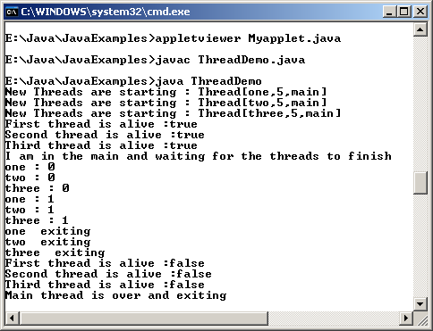
Example Contd…
Output

Slide 10
Thread Synchronization
At times, two or more threads may try to access a resource at the same time.
  For example, one thread might try to read data from a file while another one tries to change the data in the same file
In such a case, data may become inconsistent.
To ensure that a shared resource is used by only one thread at any point of time, we use synchronization.

Slide 11
Thread Synchronization Contd…
Synchronization is based on the concept of monitor.
A monitor is an object that is used as a mutually exclusive lock.
Only one thread can enter a monitor.
When one thread enters the monitor, it means that the thread has acquired a lock and all other threads must wait till that thread exits the monitor.
For a thread to enter the monitor of an object, the programmer must invoke a method created using the synchronized keyword.
Owner of the method has to exit from the method to give up the control.

Slide 12
Example
class One
{
synchronized void display(int num)
{
System.out.print(""+num);
try
{
Thread.sleep(1000);
}
catch(InterruptedException e)
{
System.out.println("Interrupted");
}
System.out.println(" done");
}
}
class Two implements Runnable
{
int number;
One objOne;
Thread objTh;
public Two(One one_num, int num)
{
objOne = one_num;
number = num;
objTh = new Thread(this);
objTh.start();
}
public void run()
{
objOne.display(number);
}
}
class SynchMethod
{
public static void main(String args[])
{
One objOne = new One();
int digit = 10;
Two objSynch1 = new Two(objOne,digit++);
Two objSynch2 = new Two(objOne,digit++);
Two objSynch3 = new Two(objOne,digit++);
//wait for threads to end
try
{
objSynch1.objTh.join();
objSynch2.objTh.join();
objSynch3.objTh.join();
}
catch(InterruptedException e)
{
System.out.println("Interrupted");
}
}
}

Slide 13
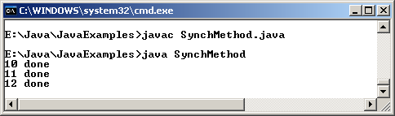
Example Contd..
Output

Slide 14
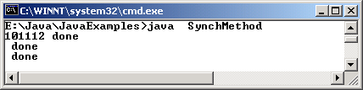
Race condition
If synchronized keyword is omitted from the previous example, all the threads can simultaneously invoke the same method, on the same object.
This condition is known as race condition.
Race conditions in a program are possible when
  Two or more threads share data
  They are reading and writing the shared data simultaneously
Output
Without
Synchronization

Slide 15
Synchronized Block
It is not always possible to achieve synchronization by creating synchronized methods within classes.
We can put all calls to the methods defined by this class inside a synchronized block.
A synchronized block ensures that a method can be invoked only after the current thread has successfully entered object’s monitor.
The example shown earlier can be modified with the synchronized keyword used in the method run() of the class ‘One’.

Slide 16
Using ‘wait-notify’ mechanism
Java provides well designed inter-process communication mechanism using the wait(), notify() and notifyAll() methods.
The methods are implemented as final methods in the class Object.
wait(), notify() and notifyAll() can be called only from within a synchronized method.

Slide 17
Using ‘wait-notify’ mechanism Contd…
wait() method tells the calling thread to exit and enter the sleep state till some other thread enters the monitor and calls the notify() method.
notify()method wakes up the first thread that called wait().
notifyAll() wakes up or notifies all the threads that called wait().
Once all the thread are out of sleep mode, the thread that has the highest priority will run first.

Slide 18


Using ‘wait-notify’ mechanism Contd…
notify()
First thread
notify() wakes up or notifies the first thread.
notifyAll()
Thread 2
notifyAll() wakes up or notifies all the threads that called wait( ) on the same object.
Thread 1
Thread 3

Slide 19
wait()
Points to remember while using the wait() method:
  The calling thread gives up the CPU.
  The calling thread gives up the lock.
  The calling thread goes into the waiting pool of the monitor.

Slide 20
notify()
Main points to remember about notify():
  One thread moves out of the waiting pool of the monitor and into the ready state.
  The thread that was notified must reacquire the monitor’s lock before it can proceed since it was in sleep state and no longer had the control of the monitor.

Slide 21
Example
class ChopStick
{
boolean available;
ChopStick()
{
available = true;
}
public synchronized void takeup()
{
while(!available)
{
try
{
System.out.println("Philosopher is waiting for the other chopstick");
wait();
}
catch(InterruptedException e)
{ }
}
available = false;
}
public synchronized void putdown()
{
available = true;
notify();
}
}
class Philosopher extends Thread
{
ChopStick left,right;
int philo_num;
Philosopher(int num, ChopStick chop1,ChopStick chop2)
{
philo_num = num;
left = chop1;
right = chop2;
}
public void eat()
{
left.takeup();
right.takeup();
System.out.println("Philosopher "+(philo_num+1)+" is eating");
}
public void think()
{
left.putdown();
right.putdown();
System.out.println("Philosopher "+(philo_num+1)+" is thinking");
}

Slide 22
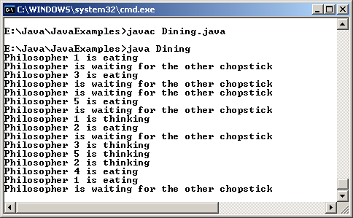
Example Contd…
public void run()
{
while(true)
{
eat();
try
{
sleep(1000);
}
catch(InterruptedException e)
{}
think();
try
{
sleep(1000);
}
catch(InterruptedException e)
{}
}
}
}
//end of class
class Dining
{
static ChopStick[] chopsticks = new ChopStick[5];
static Philosopher[] philos = new Philosopher[5];
public static void main(String args[])
{
for (int count = 0;count <= 4;count++)
{
chopsticks[count] = new ChopStick();
}
for (int count = 0;count <= 4;count++)
{
philos[count] = new Philosopher(count,chopsticks[count],chopsticks[(count+1)%5]);
}
for (int count = 0;count <= 4;count++)
philos[count].start( );
}
}
Output

Slide 23
Deadlocks
Occurs when two threads have a circular dependency on a pair of synchronized objects.
  For example: one thread enters the monitor on object ‘ObjA’ and another thread enters the monitor on object ‘ObjB’.
  If the thread in ‘ObjA’ attempts to call any synchronized method on ‘ObjB’, a deadlock occurs.

Slide 24
Example
public class DeadlockDemo implements Runnable
{
public static void main(String args[])
{
DeadlockDemo objDead1 = new DeadlockDemo();
DeadlockDemo objDead2 = new DeadlockDemo();
Thread objTh1 = new Thread (objDead1);
Thread objTh2 = new Thread (objDead2);
objDead1.grabIt = objDead2;
objDead2.grabIt = objDead1;
objTh1.start();
objTh2.start();
System.out.println("Started");
try
{
objTh1.join();
objTh2.join();
}
catch(InterruptedException e)
{
System.out.println("error occurred");
}
System.exit(0);
}
DeadlockDemo grabIt;
public synchronized void run()
{
try
{
Thread.sleep(500);
}
catch(InterruptedException e)
{
System.out.println("error occurred");
}
grabIt.syncIt();
}

Slide 25
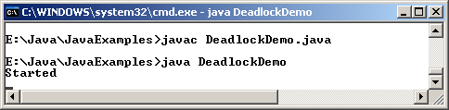
Example Contd…
public synchronized void syncIt()
{
try
{
Thread.sleep(500);
System.out.println("Sync");
}
catch(InterruptedException e)
{
System.out.println("error occurred");
}
System.out.println("In the syncIt() method");
}
}// end class
Output

Slide 26

Garbage collection
It is a process whereby the memory allocated to objects, which are no longer in use, may be reclaimed or freed.
Java automatically frees the memory that is no longer required.
Thus programmers do not have to worry about garbage collection at all.
An object becomes eligible for garbage collection if there are no references to it or if it has been assigned to null.

Slide 27
Garbage Collection Contd…
Garbage collector runs as a separate low priority thread.
Garbage collector can be invoked by invoking that instance’s gc () method.
There is no guarantee that garbage collection will take place right then.

Slide 28
Using the finalize method
Java provides a way that is similar to C++ destructors, which can be used for cleaning up process before the control returns to the operating system.
The finalize() method if present will be executed prior to garbage collection only once per object. Syntax of the method is:
  protected void finalize() throws Throwable
Referrences cannot be garbage collected; only objects are.

Slide 29
Example
class GCDemo
{
public static void main(String args[])
{
int count;
long num;
Runtime objRun = Runtime.getRuntime();
Long values[] = new Long[200];
System.out.println("Amount of free memory is " + objRun.freeMemory());
objRun.gc();
System.out.println("Amount of free memory after garbage collection is "+ objRun.freeMemory());
for(num = 10000,count = 0; count < 200; num++,count++)
{
values[count] = new Long(num);
}
System.out.println("Amount of free memory after creating array is "+ objRun.freeMemory());
for (count = 0;count < 200 ; count++)
{
values[count] = null;
}
objRun.gc();
System.out.println("Amount of free memory after garbage collection is "+ objRun.freeMemory( ));
}
}

Slide 30
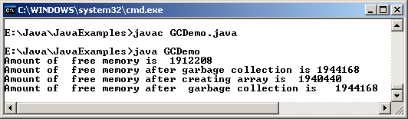
Example Contd…
Output

Slide 31
Summary
Data may get corrupted when two or more threads access the same variable or object at the same time.
The method isAlive() returns true if the thread upon which it is called is still running.
The method join() will wait until the thread on which it is called terminates.
Synchronization is a process that ensures that the resource will be used by only one thread at a time.
Synchronization does not provide any benefit for single threaded programs. In addition, their performance is three to four times slower than their non-synchronized counterparts.
The method wait() tells the calling thread to give up the monitor and enter the sleep state till some other thread enters the same monitor and calls the method notify().

Slide 32
Summary Contd…
The method notify() wakes up or notifies the first thread that called wait() on the same object.
The method notifyAll() wakes up or notifies all the threads that called wait() on the same object.
A deadlock occurs when two threads have a circular dependency on a pair of synchronized objects.
Garbage collection in Java is a process whereby the memory allocated to objects, which are no longer in use, may be reclaimed or freed.
The garbage collector runs as a low priority thread and we can never predict when it will collect the objects.

